Slide 1
481 Presentation 1
Ekhonmu, Esther, Nami, Lucy

Slide 2
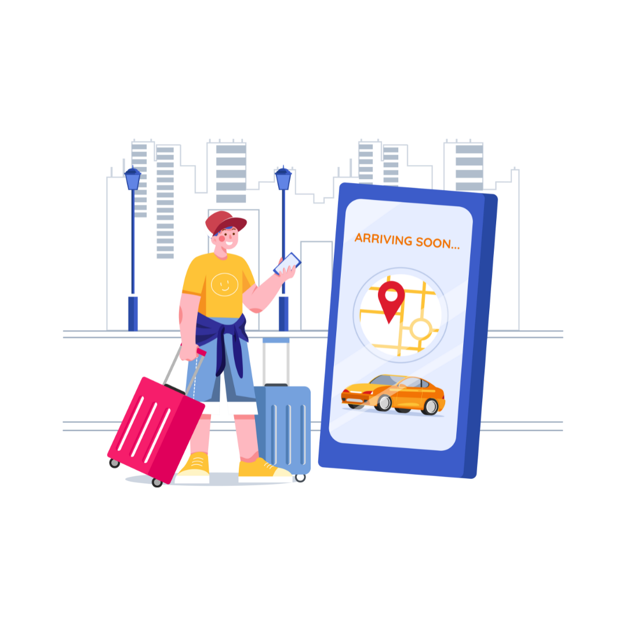
Travel company that helps clients book itinerary in Calgary
Size
Small to medium-sized travel company in Calgary, offering personalized travel experiences.
Organizational Philosophy & Vision
Travel fosters connection and personal growth.
Vision: Leader in transformative travel, focusing on safety and community.
What We Do
Local event booking, curated itineraries, and essential services like hotels and transportation.

Slide 3
What’s the Problem?
A travel company would like to have an app for their clients during their trips to calgary.
The company wants the app to allow clients to be able to book and cancel local events, view their itinerary for their visit, and finding local amenities such as hotspots, emergency contacts, restaurants, and more.

Slide 4

What are the constraints you’re working with?
Physical Constraints
Data Availability: Enable offline functionality to store itinerary data locally for users without consistent internet access while travelling.
User Accessibility: Design app to be accessible all types of users, this includes providing support for features like screen readers, voice commands, multilingual support, and larger text for users with disabilities.
Budget Constraints
Marketing and Maintenance: Ongoing costs for maintaining the app, server hosting, customer support and updates.
Third-Party APIs: Integrating APIs for booking systems or local events may require licensing fees.
Notes:
Physical Constraints:
Data Availability: Enable offline functionality to store itinerary data locally for users without consistent internet access while travelling.
User Accessibility: Design app to be accessible all types of users, this includes providing support for features like screen readers, voice commands, multilingual support, and larger text for users with disabilities.
Budget Constraints:
Marketing and Maintenance: Ongoing costs for maintaining the app, server hosting, customer support and updates.
Third-APIs: Integrating APIs for booking systems or local events may require licensing fees.
Platform/System Constraints:
Post-Covid Protocols: The app should offer real time updates for travel restrictions, health protocols or emergency procedures, which can vary by location.
Integration with Existing Systems: The app may need to integrate with external booking systems, payment gateways or databases for storing client information securely.
Operating system compatibility: Needs to be compatible with both IOS and Android to reach widest audience. Also should consider if we are using cross platform tools.

Slide 5

Platform/System Constraints
Post-Covid Protocols: The app should offer real time updates for travel restrictions, health protocols or emergency procedures, which can vary by location.
Integration with Existing Systems: The app may need to integrate with external booking systems, payment gateways or databases for storing client information securely.
Operating system compatibility: Needs to be compatible with both IOS and Android to reach widest audience. Also should consider if we are using cross platform tools.

Slide 6
Our Research
User experience from the meetup app. Lists upcoming events in the city, events signed up for, map view, direct messaging feature.
Personal knowledge from signing up for events online. Ability to make payment through the applications was always available. (Ticketmaster, seatgeek, etc)
Assumptions on the functionality of tour guides were made, based on what we know that tour guides typically do.
Engaged in discussion with an event organizer and an exchange student.

Slide 7
Users in brief
Inexperienced Singular Tourist:
May need guidance on booking and local attractions, with user-friendly features.
Inexperienced Group Tourist:
Requires options for group bookings and shared itineraries, plus advice on group-friendly activities.
Experienced Tourist:
Likely seeks advanced features such as customizable itineraries and exclusive local events.
Tour Guide:
May use the app to manage group activities, share itineraries, and provide recommendations.
Event Organizer:
Needs tools for managing events, including booking, cancellations, and communication with attendees.
The proposed user types cover a broad range of tourists and professionals involved in travel. The inclusion of inexperienced and experienced tourists ensures that both basic and advanced needs are met.

Slide 8
User 1
Name: Annie January
Age: 25
Demographics: Young adult, likely tech-savvy but inexperienced with travel planning.
Role in Environment: Inexperienced Tourist (singular)
Skill Level/Knowledge: Familiar with using apps and mobile devices but may require guidance on navigation. Limited knowledge of Calgary and its attractions; needs comprehensive information.
Goal: Wants to discover popular sights and hidden gems in the city. Requires a straightforward process for booking tours and activities. Needs clear directions and transport options to reach her chosen destinations.

Slide 9
User 2
Name: Wednesday Addams
Age: 19
Demographics: Young adult, likely interested in music and social experiences.
Role in Environment: Inexperienced Tourist (group)
Skill Level/Knowledge: Familiar with using apps for booking and social media, but may need guidance on local event navigation. Limited experience with travel planning, especially in a group context.
Goal: Aims to attend at least 3 music events during her 7-day trip.Needs easy access to view ticket prices and book tickets for events.Requires information on transportation options to get to various venues. Looking for features that allow her to coordinate plans with friends effectively.

Slide 10
User 3
Name: Dominic Terry
Age: 39
Demographics: Middle-aged adult with previous travel experience, likely seeking cultural and social engagement.
Role in Environment: Experienced Tourist
Skill Level/Knowledge: Comfortable using travel apps and websites for research and bookings. Familiar with Calgary, including its landmarks and general offerings.
Goal: Looking for fresh and interesting events that he hasn’t experienced during previous visits. Interested in local arts, music, and community happenings to enhance his visit. Values personalized suggestions that cater to his interests and preferences.

Slide 11
User 4
Name: Saul Goodman
Age: 49
Demographics: Experienced tour guide with a strong understanding of local attractions and events.
Role in Environment: Tour guide
Skill Level/Knowledge: Proficient in using mobile apps and communication tools for event management. In-depth knowledge of Calgary’s attractions and cultural offerings.
Goal: Wants to easily view and manage attendees for both upcoming and past events. Needs the ability to interact with attendees via messaging or mass broadcasts to share updates and information. Wants to maintain a rating profile to reflect his performance and enhance trust with clients.

Slide 12
User 5
Name: Anthony Donaldson
Age: 62
Demographics: Older adult with experience in organizing events, likely knowledgeable in his field.
Role in Environment: Event Organizer
Skill Level/Knowledge: Familiar with event management software and platforms, though he may prefer user-friendly interfaces. Experienced in hosting seminars and managing attendee logistics.
Goal: Wants to easily list an economics seminar on the platform, including details like location, date, time, and capacity. Needs the ability to view and manage the list of attendees for the seminar. Requires functionality to issue waivers or necessary forms to attendees.

Slide 13
Tasks
Travelers
Tour guides/Event organizers
Viewing the main menu
Click into pages categorized by different types of events (Famous landmarks, restaurants, concerts/festivals, outdoor activities, emergency contacts)
Filtering through events
Leaving 5 star reviews on an event
Access to a map view to display the location of events
Booking an event (upcoming events also)
Viewing booked events
Canceling a booked event
Contacting event organizers
Listing events (organizers only)
Setting special promos and countdowns on events (organizers only)
Deleting and editing events (organizers only)
Broadcasting message (event organizers and tour guides)

Slide 14
Task Example 1
User: Annie January, 25, tourist visiting Calgary.
Goal: Annie's wants to discover interesting local attractions in Calgary, find places to eat, and have access to emergency services in case of need. She also aims to have a clear, updated itinerary that guides her throughout her trip.
Who is the stakeholder or secondary actor?
Event organizers and local businesses (restaurants, hotspots, etc.) that offer services.
Tour guides and service staff responsible for managing bookings and providing customer support.
What is the success condition?
Annie successfully books local events and tours, views her itinerary, and finds information on local amenities like restaurants, emergency contacts, and popular attractions. She must be able to do this seamlessly within the app, with clear instructions on how to reach locations and confirmation of her bookings.

Slide 15
Task Example 1
What are the steps taken to do the tasks?
Annie opens the app.
She creates an account or logs in.
Annie views the main menu with various attraction categories.
She clicks the "Popular Landmarks" button.
She browses through the list of landmarks and finds Calgary Tower interesting.
Annie clicks on Calgary Tower to see more details.
She notices an option to book dinner at the restaurant in Calgary Tower.
Annie views available times for the dinner.
She selects a preferred date and time.
Annie confirms the booking.
She receives a booking confirmation.
The booked dinner appears in her itinerary.
She sees transportation options to Calgary Tower in her itinerary.
Annie finds the event organizer's contact information in case she needs more information.
She also has the option to cancel the dinner booking if needed.
Annie can contact the app’s support for help if required.

Slide 16
Task Example 1
What kind of issues arise?
User Experience Issues:
Difficulty navigating the app as a first-time user (confusing menus, hard-to-find buttons).
Lack of clear instructions for canceling bookings or changing event times.
Booking Issues:
Overbooked events that cannot accommodate Annie’s request.
Payment failure due to processing issues or connectivity problems.
Information Issues:
Inaccurate or outdated information on local events, tours, or attractions (e.g., closed venues, canceled events).

Slide 17
Task Example 1
User’s knowledge level with the task
She is a new user to the app, looking for things to do in her visit to calgary. She knows next to nothing about calgary. She should be able to view the available local sights on the app, and how to get there. Ability to book a tour through the company is essential.
Is this a common task for the user or an uncommon task?
This is a common task for user

Slide 18
Task Example 2
User: Anthony Donaldson, 62, Calgary native.
Goal: Anthony’s goal is to host an event in calgary with minimal issues. He wants to be able to select a venue to host this event, and display the relevant information about the event as necessary. Anthony wants to be able to set a limit on how many people can attend. He also wants to be able to view the attendees, and contact them all as necessary, with the ability to attach forms to the event listing, such as waivers and dietary restrictions.
Who is the stakeholder or secondary actor?
The travel company providing the app.
Local or international attendees listed as tourists on the app.
What is the success condition?
Anthony successfully lists his event, with the ability to edit and delete the event as he sees fit, and receives a confirmation of his event being listed. He is also able to successfully contact all attendees of the event, either through private conversation, or through mass broadcast. He must be able to do this easily through the application, with the attendees being unable to broadcast messages.

Slide 19
Task Example 2
What are the steps taken to do the tasks?
Anthony opens the app.
He creates an account or logs in.
He views the main menu and selects the "Events" section.
Anthony clicks the "Add Event" button.
He fills in the event details: name, date, time, location, and attendance limit.
Anthony submits the event information.
He receives confirmation that the event has been listed.
He selects the event to view the attendees.
Anthony views the list of registered attendees and their contact information.
He clicks on an attendee to send a private message.
Anthony navigates to the "Attach Forms" section.
He uploads any necessary forms, such as waivers or dietary restrictions.
He confirms the attachment of the forms to the event listing.
Anthony saves all changes to finalize the event setup.

Slide 20
Task Example 2
What kind of issues arise?
User Experience Issues:
Difficulty navigating the app as a first-time user (confusing menus, hard-to-find buttons).
Lack of clear instructions for listing bookings or changing event times.
3rd Party Issues
Difficulty coordinating with location owners through the application.

Slide 21
Requirements
Core users: People travelling to Calgary. These will make the majority of the application’s users
Secondary users: Event holders or tour guides for the company.
Most common tasks: Viewing events/landmarks, accessing transportation. Viewing reviews.
Least common tasks: Uploading photos, deleting/editing events

Slide 22
Requirements
Must include | Should Include | Might Include | Exclude
Viewing event information | Private message between organizers and attendees | Related events | External reviews
Booking event, cancelling a booked event, listing an event | Emergency contact access | Location sharing
Reviewing events and tour guides | Adding guests | Sharing through external applications
Accessing transportation |  | Uploading photos

Slide 23
Summarize Problem
The app is being developed to streamline the travel experience for individuals exploring Calgary, making it easier for them to discover local attractions, events, and amenities.
It aims to facilitate seamless booking and communication between users and service providers, enhancing overall convenience and engagement.
By addressing the needs of various user types, the app will foster a more enjoyable and organized trip for visitors.

Slide 24
Thank you / Questions?

